Slide 1
MBS AND ENDSTAGE KIDNEY DISEASE: BRIDGE TO THE TRANSPLANT
Francesco Saverio Papadia, MD, FACS, FEBS (SurgOnc)
Department of Surgical Sciences and Integrated Diagnostics DISC
University of Genoa, Italy

Slide 2
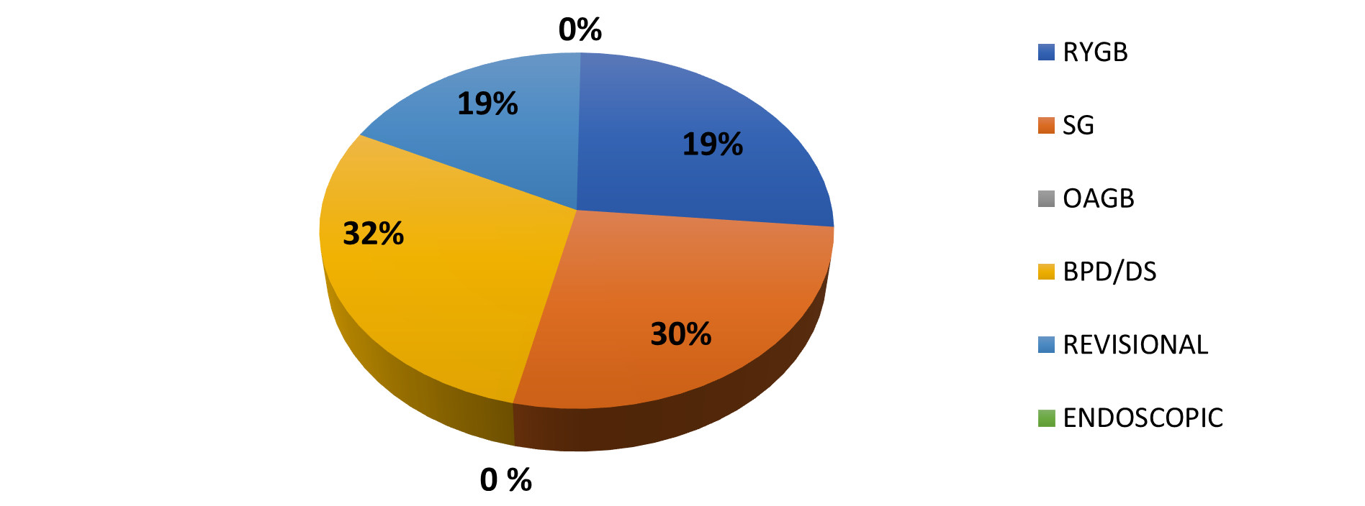
Case mix disclosure
No financial conflict of interest to disclose

Slide 3
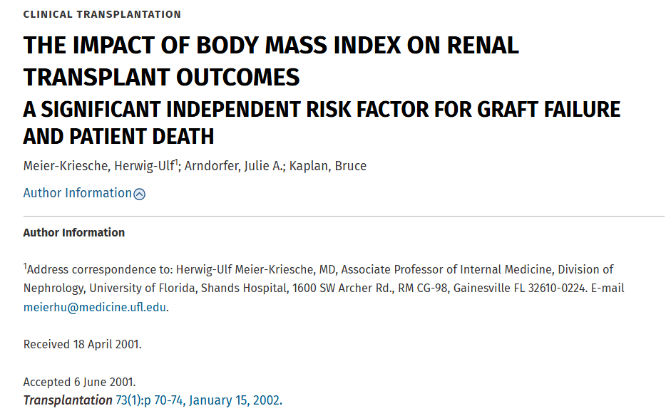

Slide 4
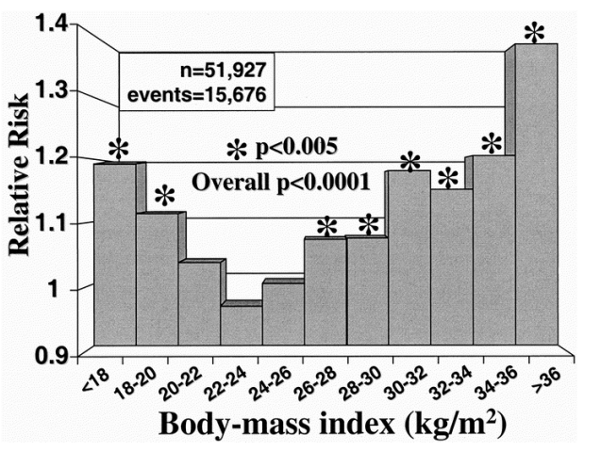
Graft loss

Slide 5
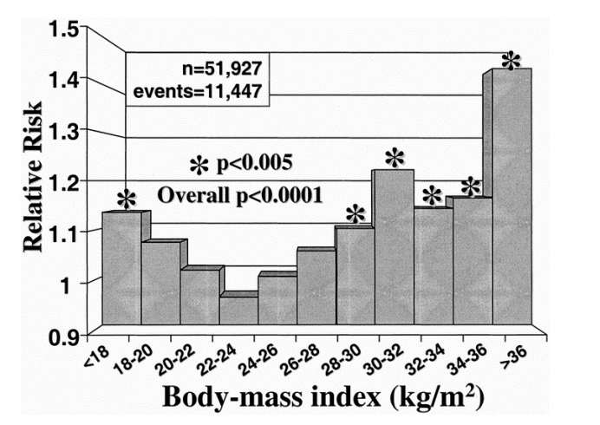
Overall mortality

Slide 6
Obesity and kidney transplant
Bariatric surgery:
BMI 30-35 kg/m² with complications
BMI >35 uncomplicated
Transplant surgery criteria:
Donor < 35 kg/m²
Recipient < 40 kg/m² (preferable, < 35)

Slide 7
Is there a role for MBS in patients with chronic kidney failure?

Slide 8
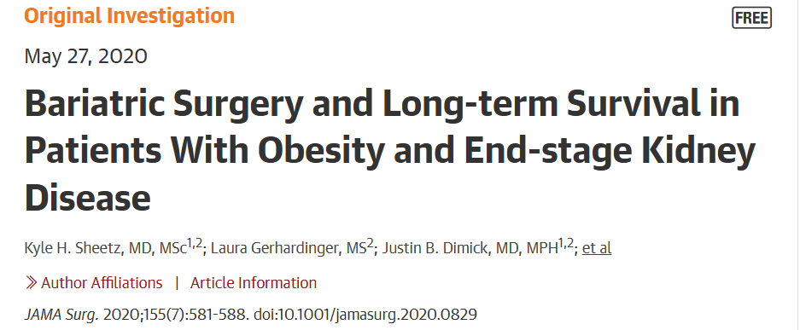

Slide 9
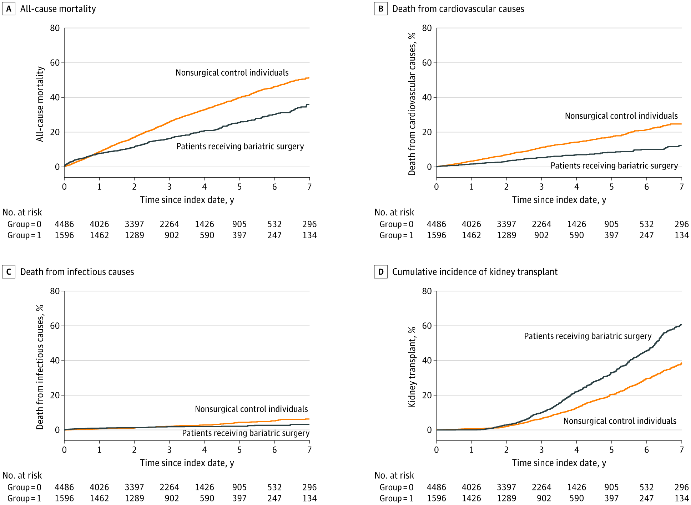

Slide 11
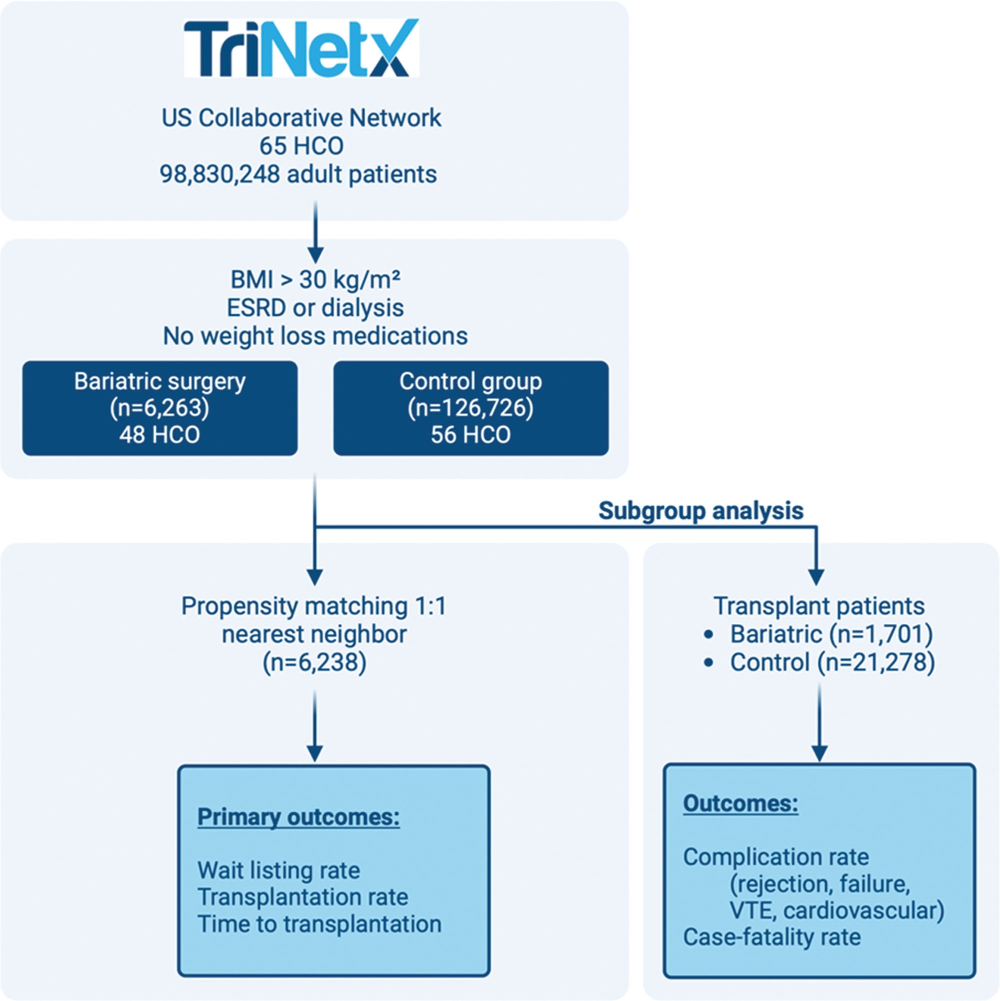
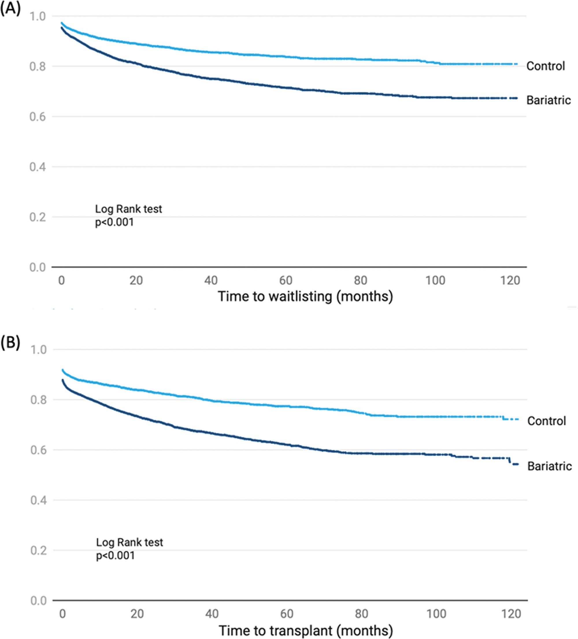

Slide 12
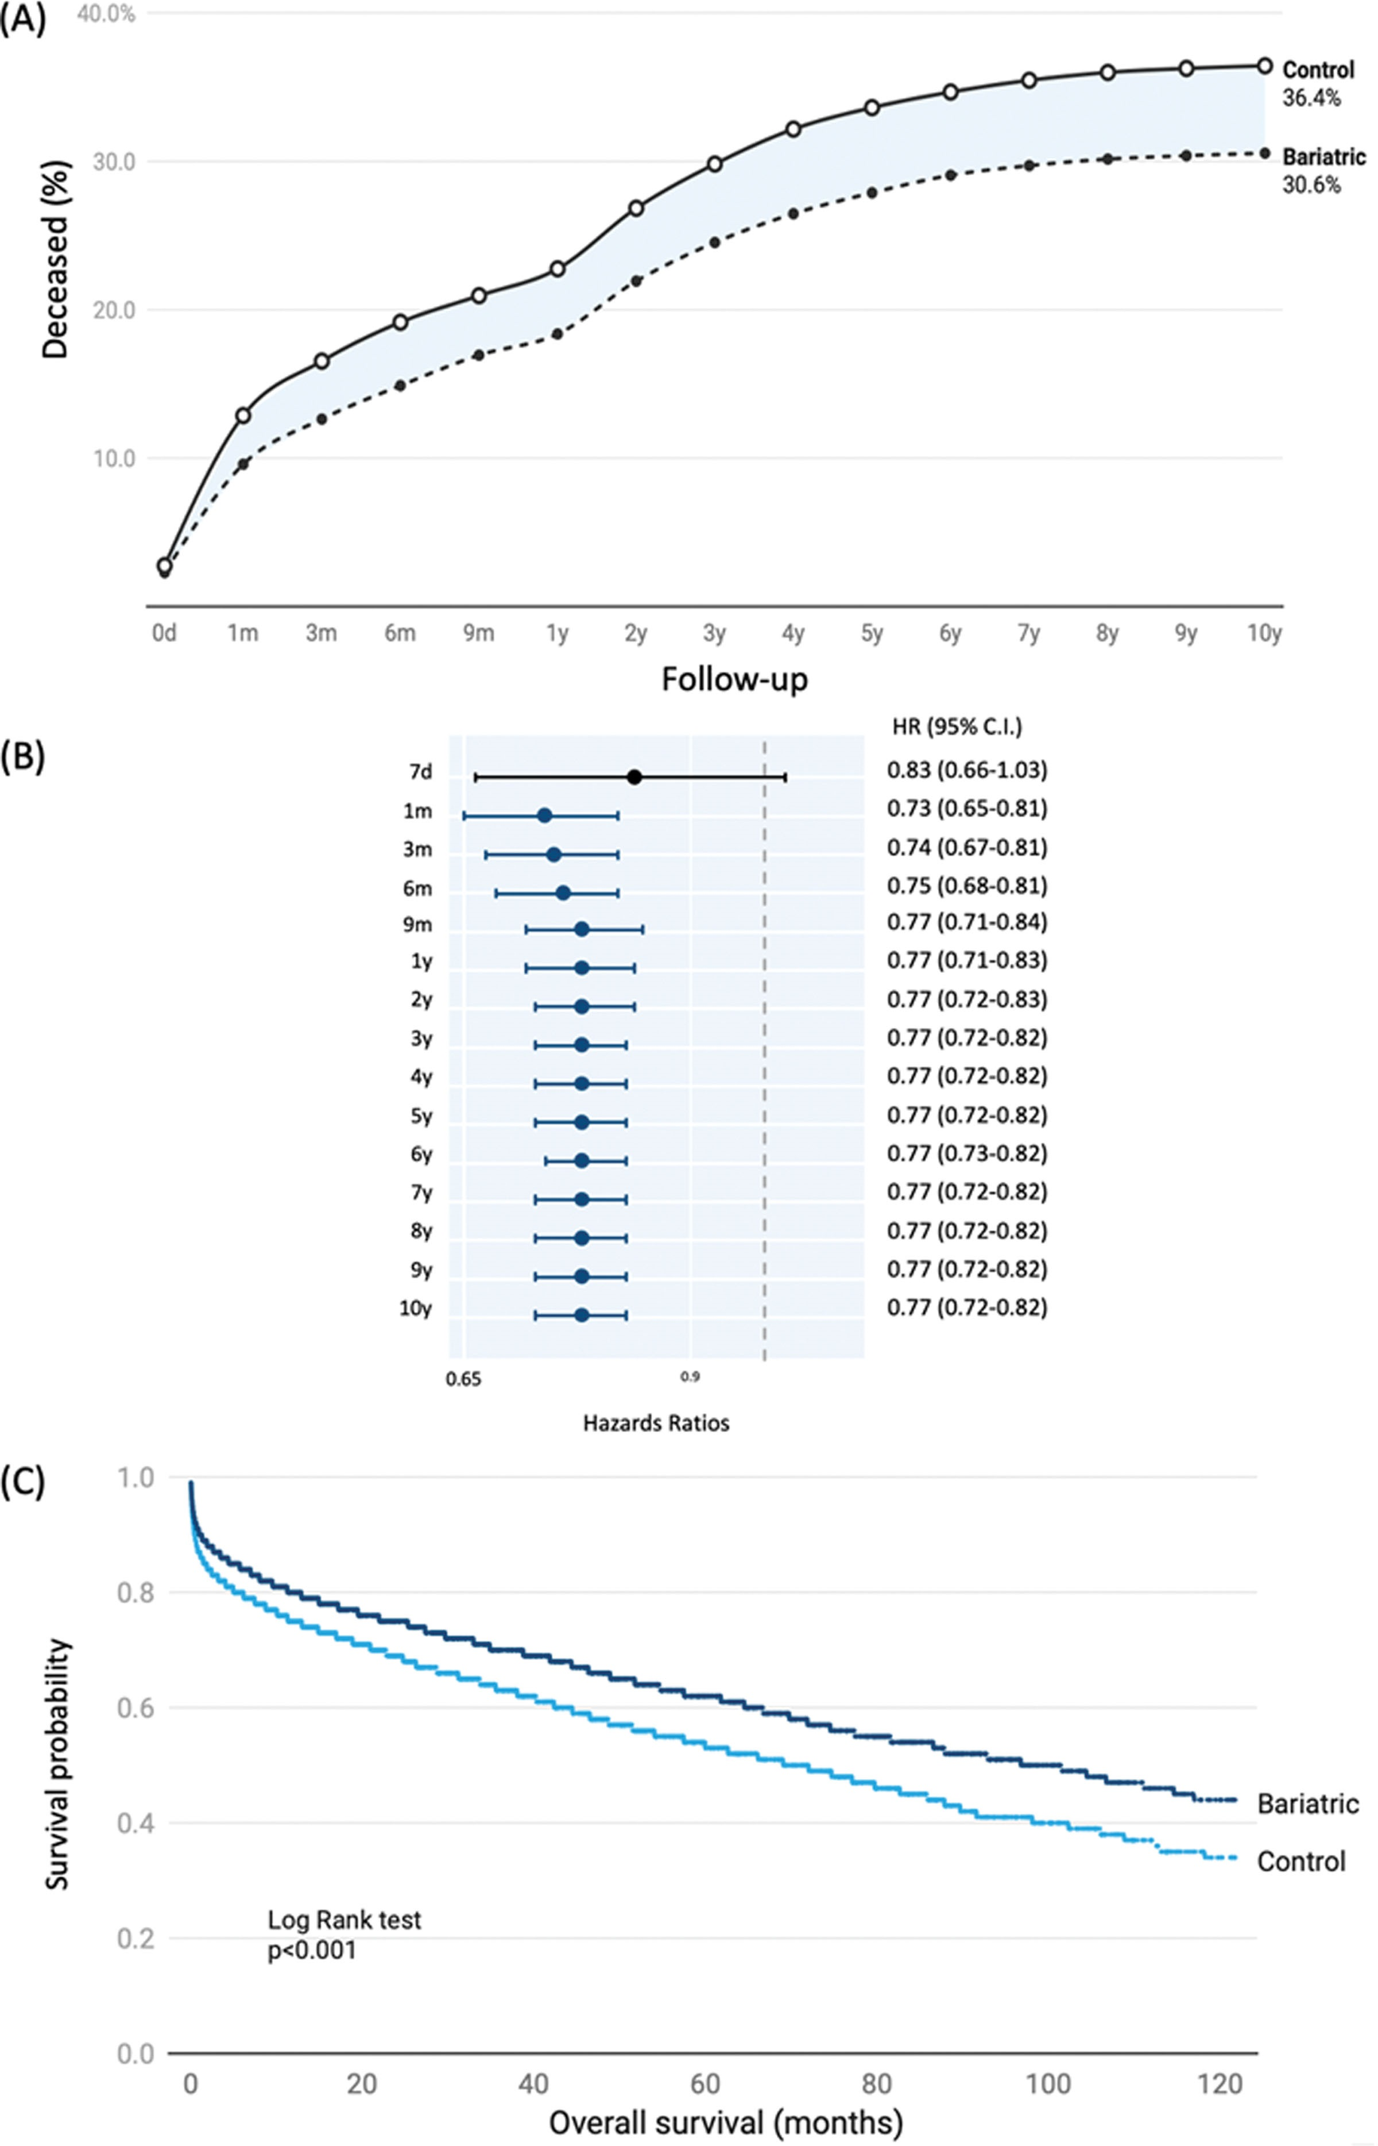
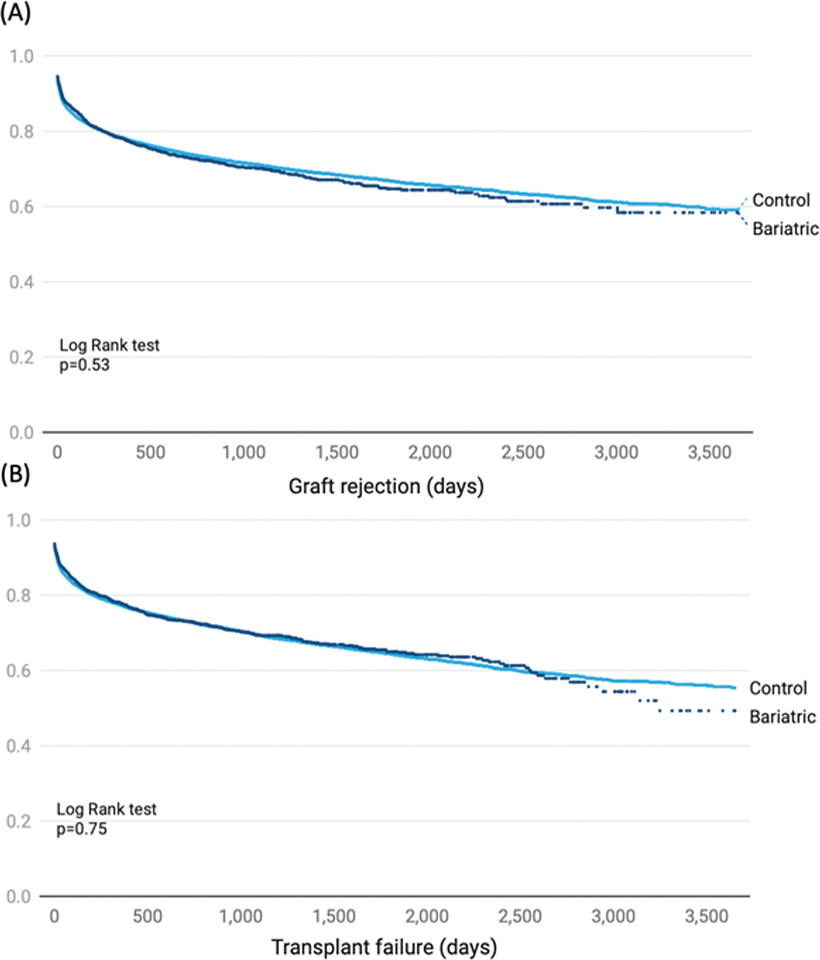

Slide 13
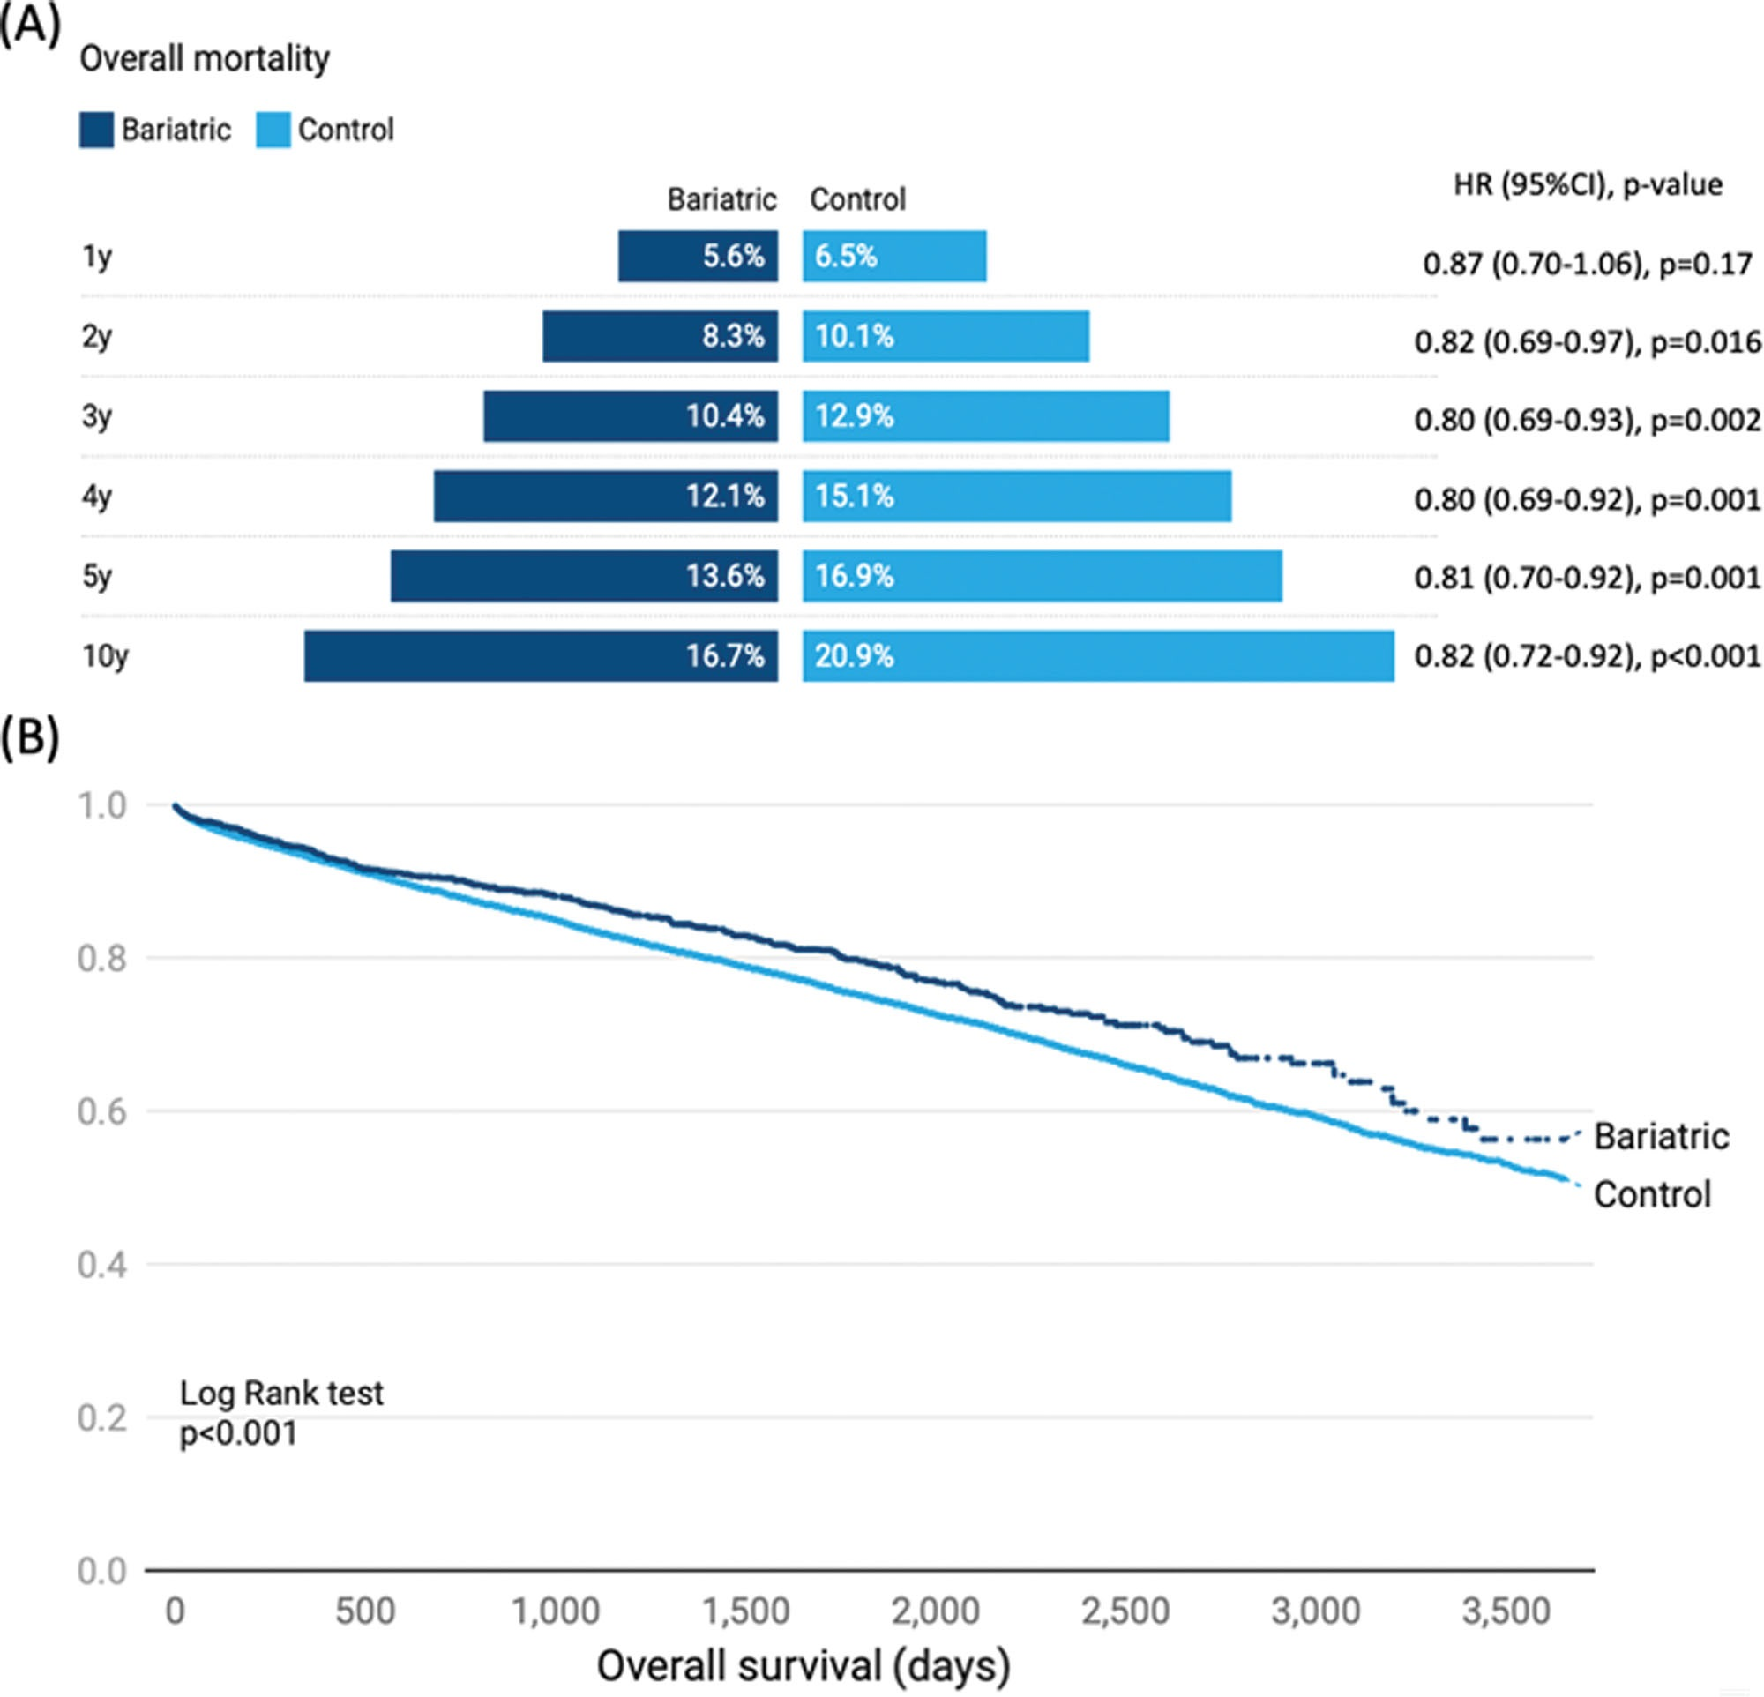

Slide 14
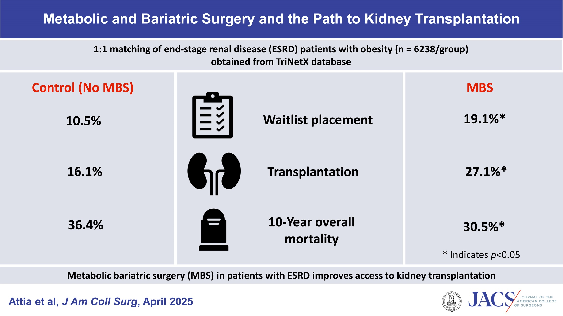

Slide 15
Timing of kidney transplant and MBS

Slide 16
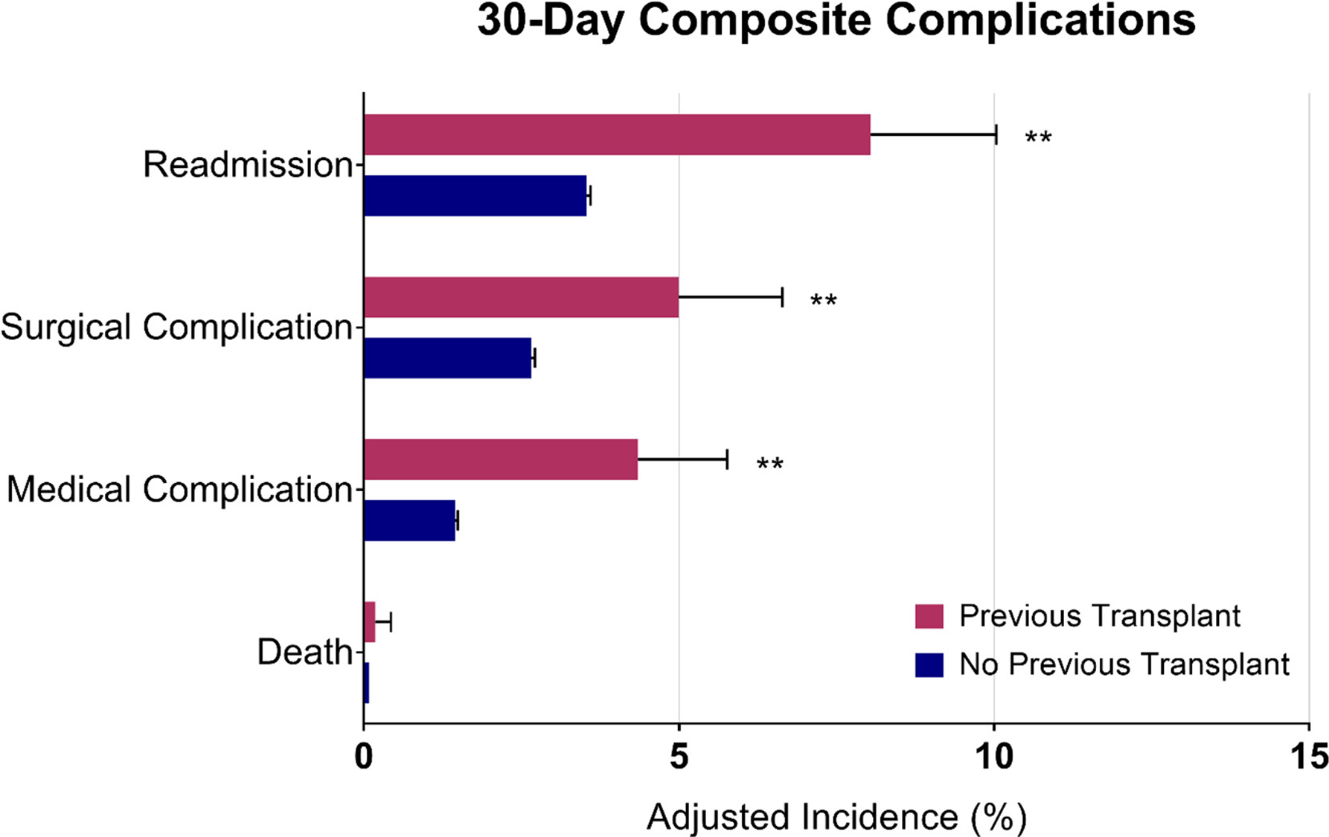

Slide 18


Slide 19
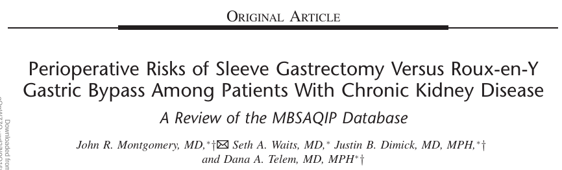
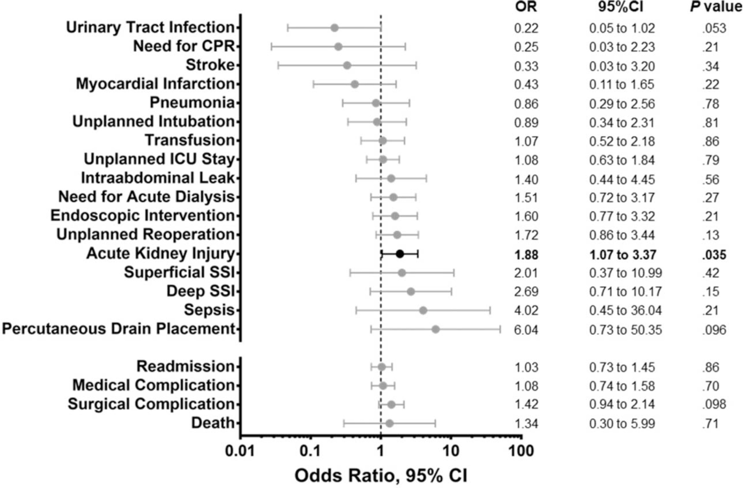
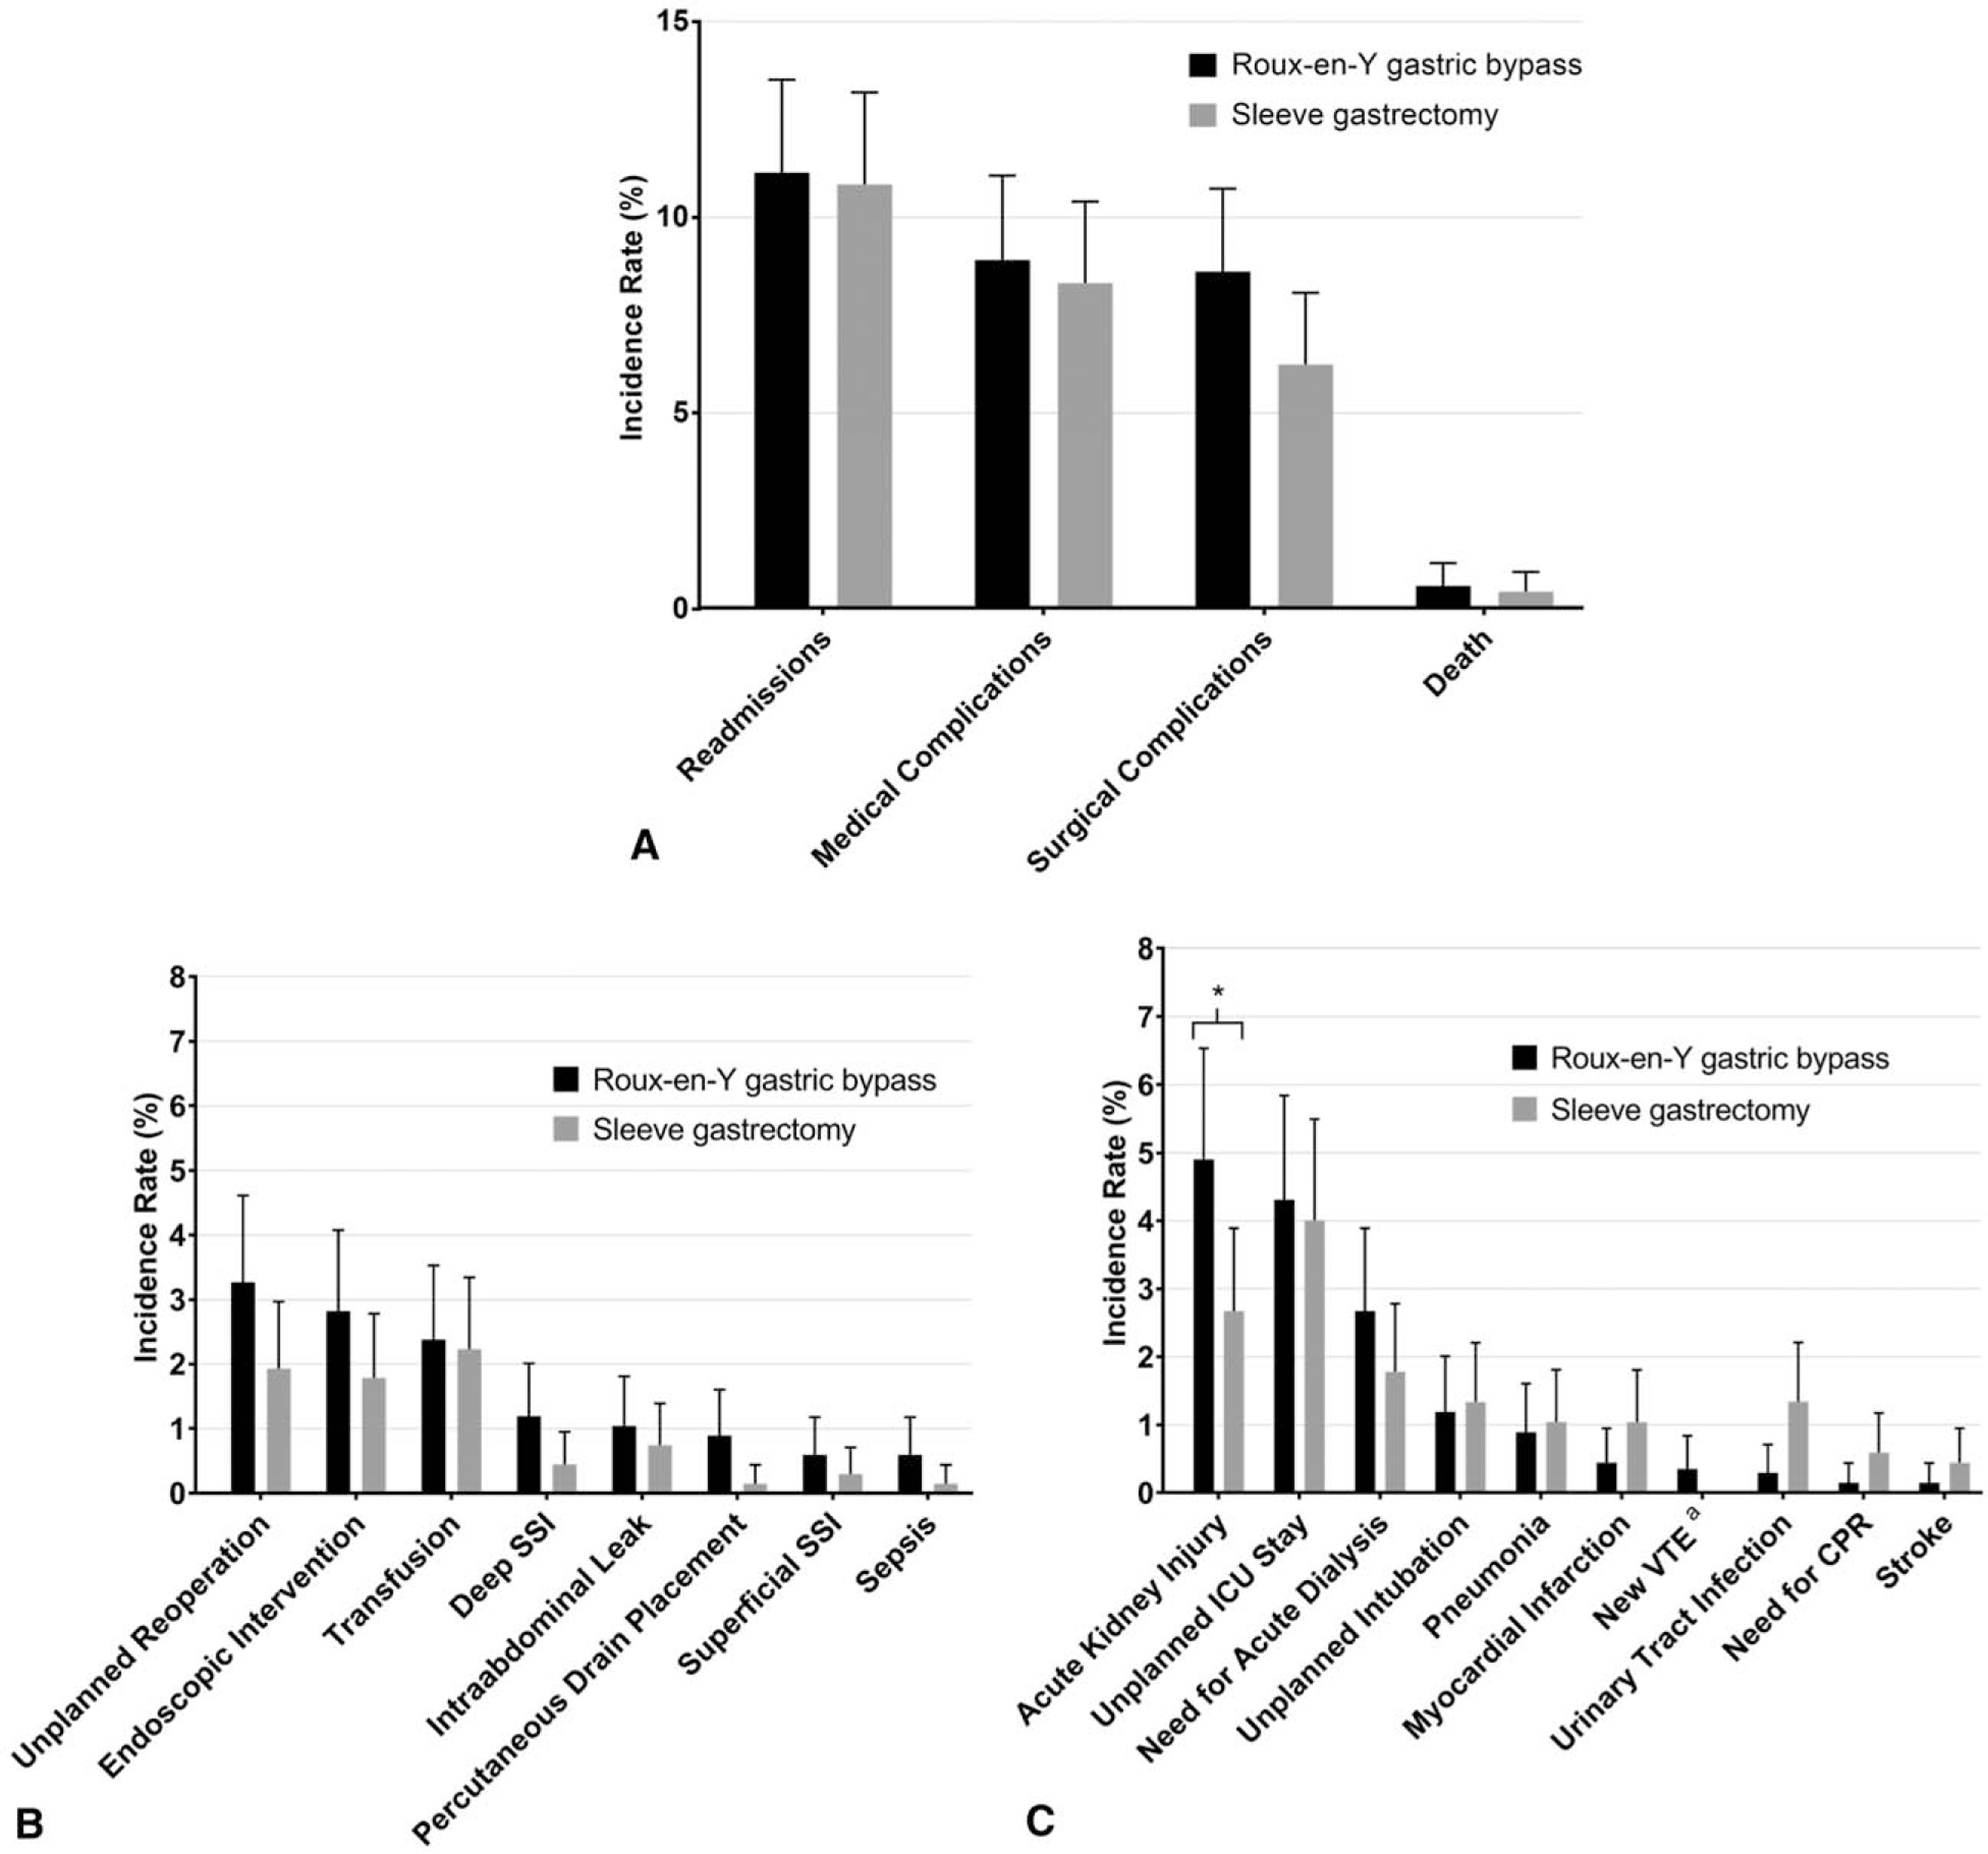

Slide 21
“….Almost half of patients with Roux-en-Y gastric bypass without a history of nephrolithiasis showed hyperoxaluria or hypocitraturia….. This prevalence was significantly higher than in body mass index matched controls. These risk factors were negated by lower urine calcium excretion in patients with Roux-en-Y gastric bypass…”

Slide 22
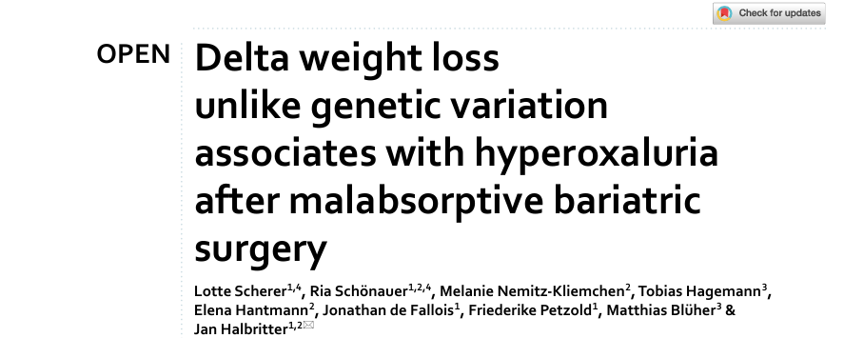
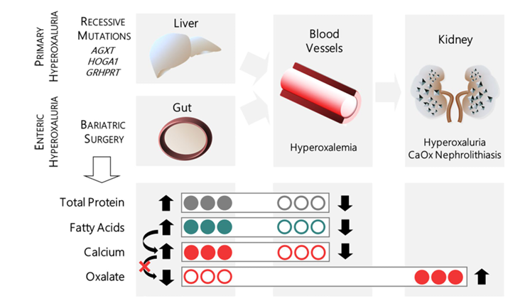

Slide 23
How does MBS compare to OMMs?

Slide 24
Semaglutide/Tirzepatide 16,8%)

Slide 26
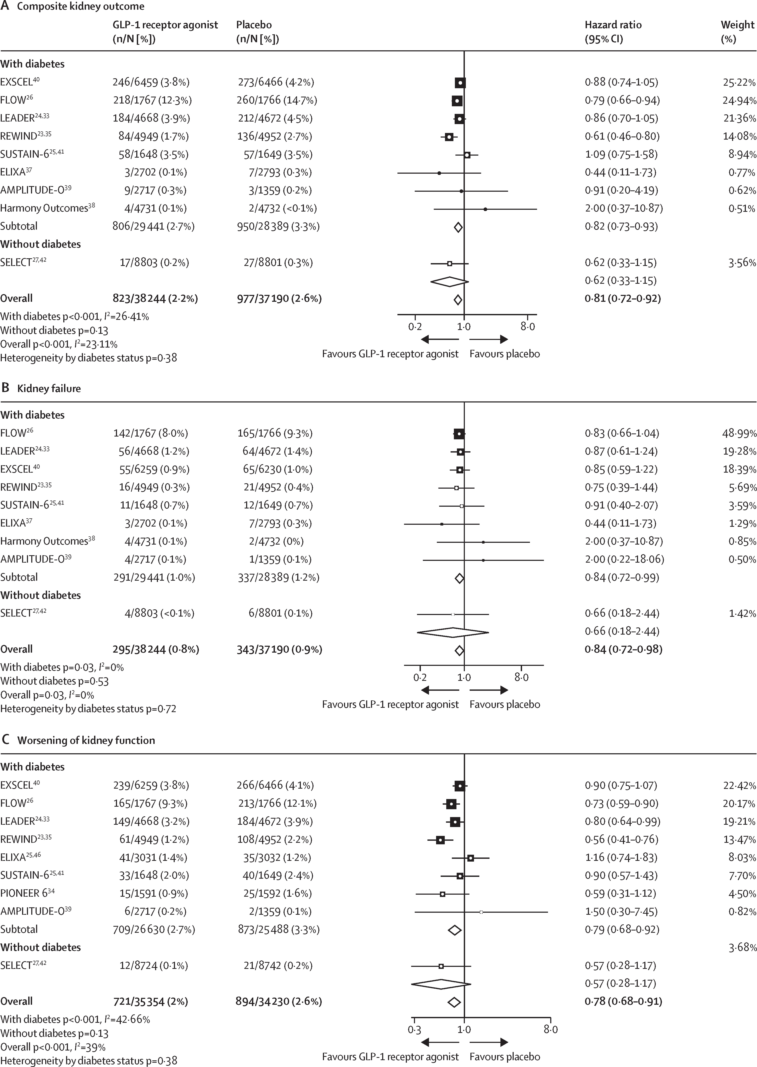

Slide 27
Conclusions
Obesity is a risk factor for ESKD and for renal transplant, as well as for graft loss
Substantial weight loss favourably impacts eligibility to kidney transplant
MBS in ESKD can be performed with (relative) safety
OMM show promising results, but long-term results are lacking, and are possibly not suitable for all patients
Probably best MBS first, then transplant
SG probably more adequate than RYGB

Slide 28
Thank you for your attention!
​
​
francesco.papadia@unige.it

Slide 29
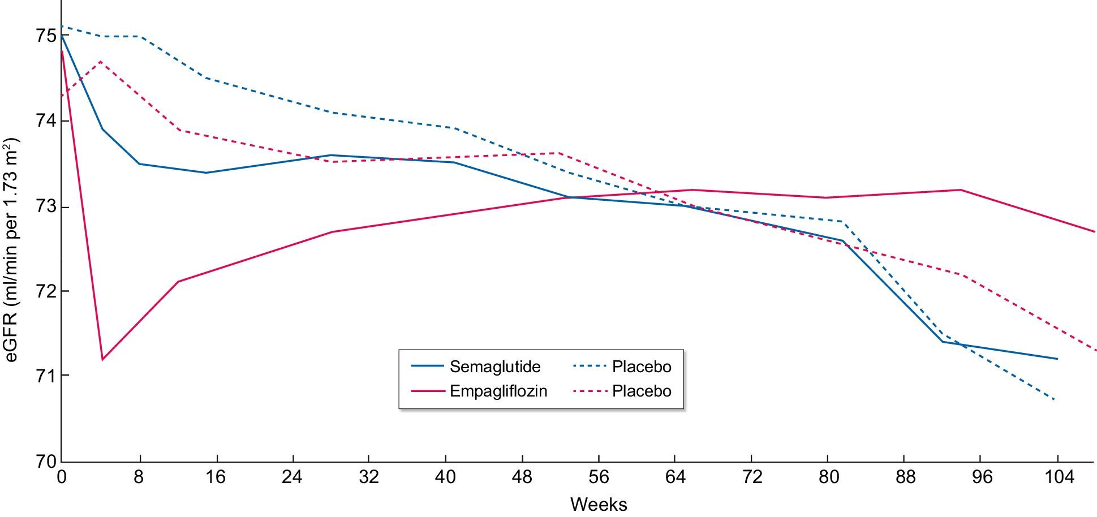

Figure 8: The early decrease in eGFR induced by SGLT2is and GLP-1 RAs appears to differ in magnitude. Results are ...
Notes:
Figure 8: The early decrease in eGFR induced by SGLT2is and GLP-1 RAs appears to differ in magnitude. Results are presented for the EMPA-REG OUTCOME trial (NCT01131676) and SUSTAIN-6 trials performed in people with T2DM who had similar baseline eGFR values [55, 81].
Unless provided in the caption above, the following copyright applies to the content of this slide: © The Author(s) 2024. Published by Oxford University Press on behalf of the ERA.This is an Open Access article distributed under the terms of the Creative Commons Attribution-NonCommercial License (https://creativecommons.org/licenses/by-nc/4.0/), which permits non-commercial re-use, distribution, and reproduction in any medium, provided the original work is properly cited. For commercial re-use, please contact journals.permissions@oup.com

